Slide 1

Smart baby
Proudly brought to you by Six Pack

Slide 2

Why is sleep important?

Slide 3

What if you had a smart device that helped you cope with daily tasks?

Slide 4

We have the answer

Slide 5
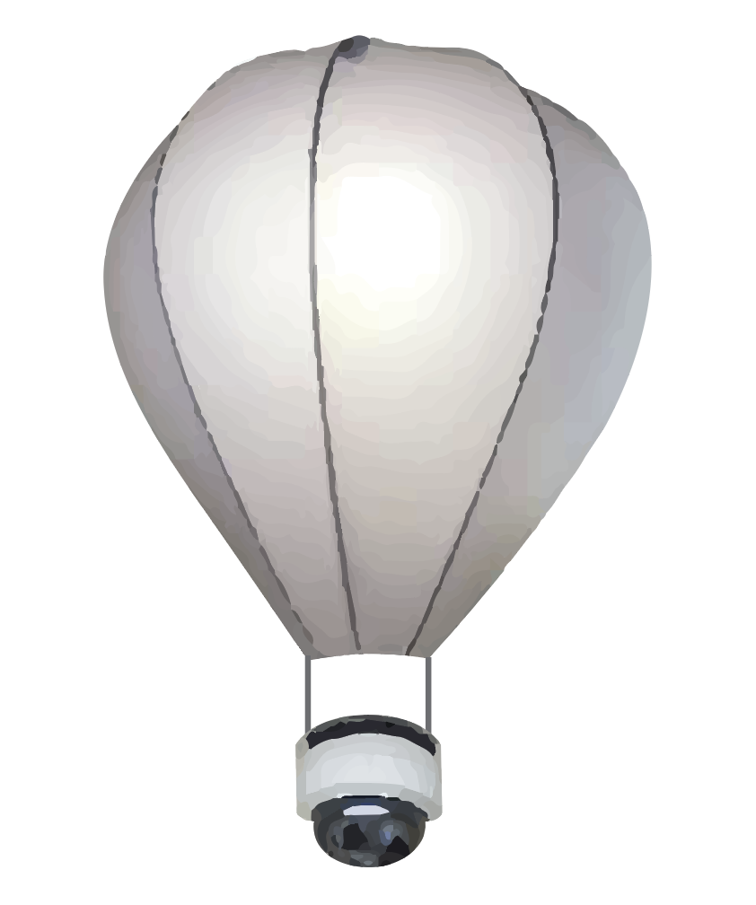

Smart Baby
Functional design
360$°$ camera
Plays stories, music, white noise
Temperature and humidity readings
Two-way talking
Functional lights
Night light
Sleep aid
Connects to your smart phone
Wi-Fi and bluetooth capabilities
Compatible with Alexa, Google Home and other home hub devices

Slide 6
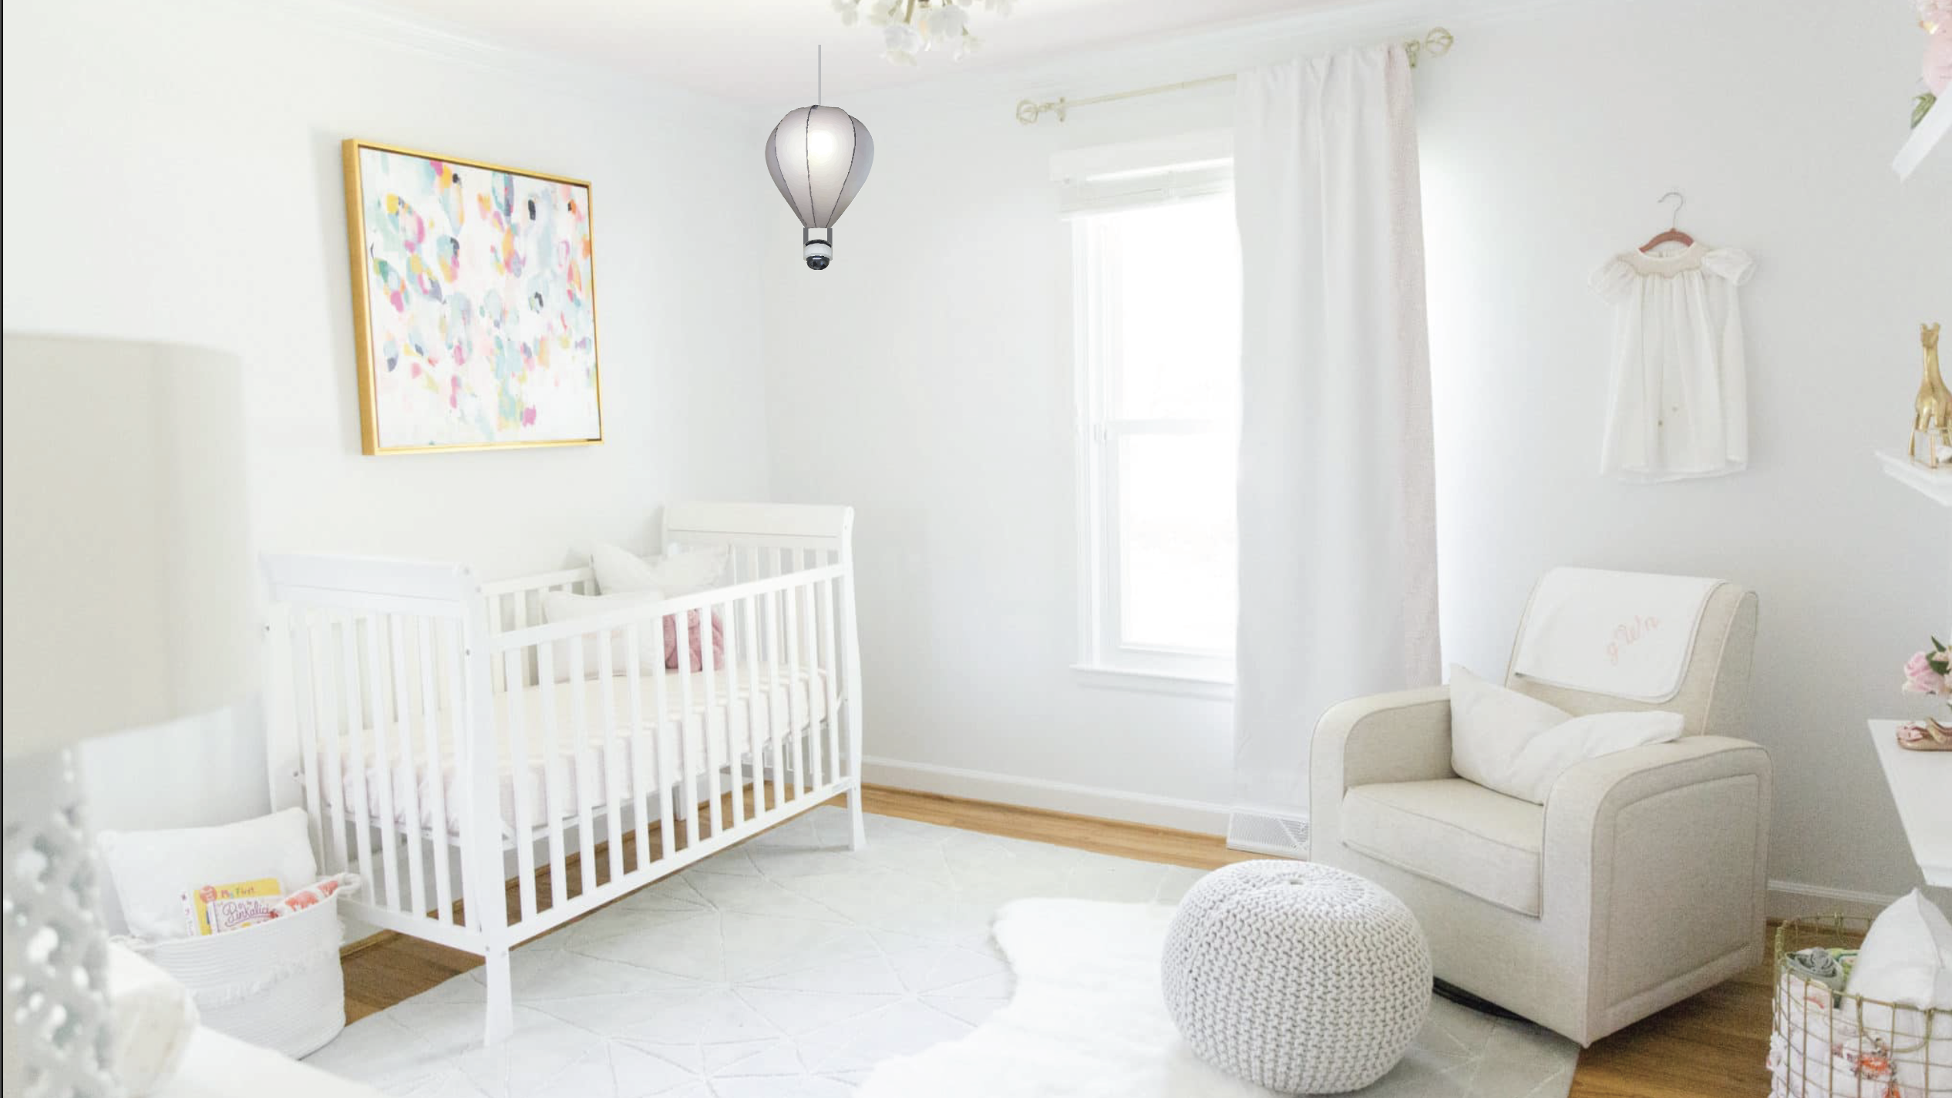
Functional design

Slide 7
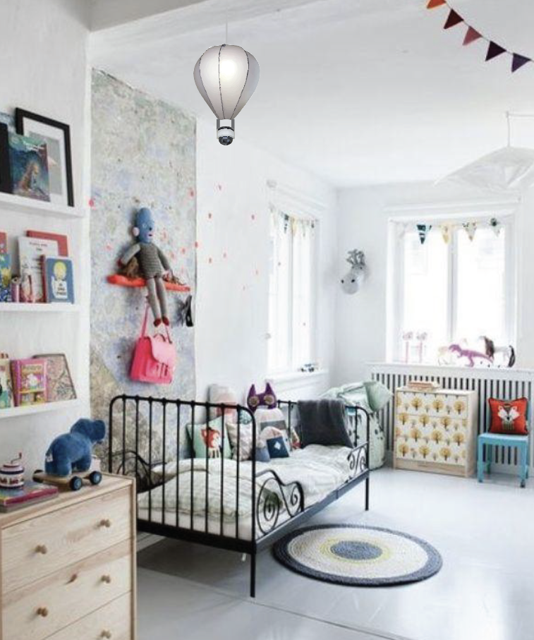
Can be a part of your child’s learning

Slide 8

Smart baby
Growing with you

